Slide 1
Foundations for NLP
Elementary Probability Theory
Essential Information Theory
Linguistic Essentials for NLP
Xiaodong Shi 史晓东

Slide 2
Elementary Probability Theory

Slide 3
Motivations
Statistical NLP assumes that many language phenomena are statistical processes. (which may not be true at all per se, but it is commonly believed)
language data is assumed to be generated in accordance with some unknown probability distribution and then we can make some inference about this distribution.

Slide 4
Motivations (Cont)
An example of statistical inference is the task of language modeling (e.g. how to predict the next word given the previous words)
In order to do this, we need a model of the language.
Probability theory helps us finding such model

Slide 5
Probability Theory
How likely it is that something will happen
Sample space Ω is listing of all possible outcome of an experiment
  coin toss (Ω = {head,tail}), die (Ω = {1..6})
  yes/no opinion poll, quality test (bad/good) (Ω = {0,1})
  spelling errors (Ω = Ζ*), where Z is an alphabet, and Z* is a set of possible strings over such and alphabet

Slide 6
Event
Sample space can be continuous or discrete. for Language applications, it is usually discrete
Event A is a set of basic outcomes
Usually A ⊂ Ω , and all A in 2^{Ω} (the event space)
  Ω is then the certain event, Ø (empty set) is the impossible event

Slide 7
Example:
  experiment: toss coin three times
    Ω = {HHH, HHT, HTH, HTT, THH, THT, TTH, TTT}
  count cases with exactly two tails:
    A = {HTT, THT, TTH}
  all heads:
    A = {HHH}

Slide 8
Probability function (or distribution)
p: 2 ^{Ω} ->[0,1]
P(Ø) = 0, P(Ω)=1
for disjoint (∩Ai=Ø) events:
P( ∪ Ai) = ΣP(Ai)
The probability of heads-up is 0.5, assuming the coin is impartial; P(HHH)=1/8

Slide 9
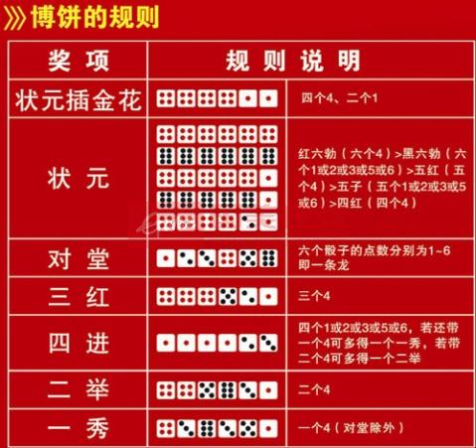
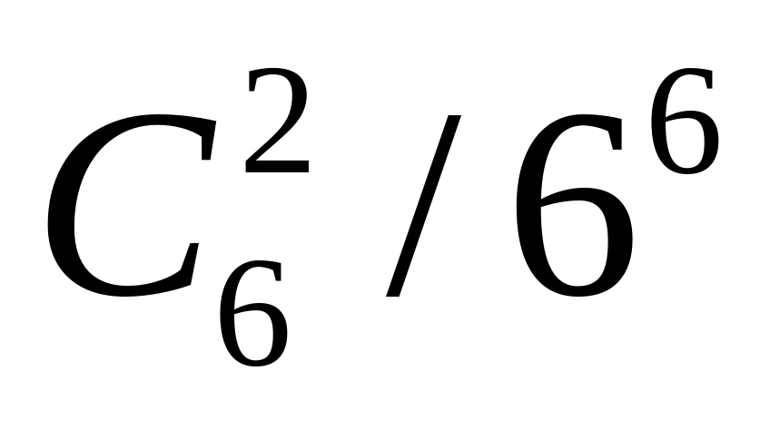
状元插金花的概率

Slide 10
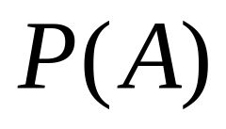
Prior Probability
Prior probability: the probability before we consider any additional knowledge

Slide 11
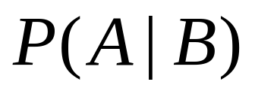
Posterior/Conditional probability
Sometimes we have partial knowledge about the outcome of an experiment
Suppose we know that event B is true
The probability that A is true given the knowledge about B is expressed by

Slide 12
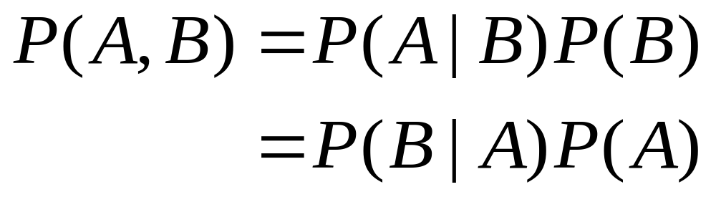
Joint probability of A and B
    A B
    A intersect B
p(A,B) = p(A intersect B)
Notes:
This rule comes from the fact that for A and B to be true we need B to be true and A to be true given B

Slide 13
Chain Rule
P(A,B) = P(A|B)P(B)
= P(B|A)P(A)
P(A,B,C,D…) = P(A)P(B|A)P(C|A,B)P(D|A,B,C..)
Notes:
Generalization of this rule to multiple events is the chain rule
The Chain Rule is used in many places in Stat NLP such as Markov Model

Slide 14
(Conditional) independence
Two events A and B are independent of each other if
P(A) = P(A|B)
for independent events,
P(A,B) = P(A)P(B)

Slide 15
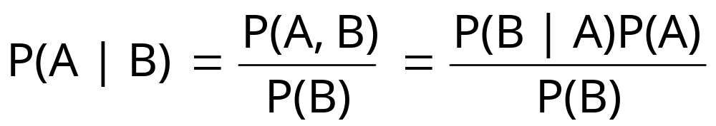
Bayes’ Theorem
Bayes’ Theorem lets us swap the order of dependence between events
Bayes’ Theorem:
Notes:
Useful when one quantity is more easy to calculate; trivial consequence of the definitions we saw but it’ s extremely useful

Slide 16
The Golden Rule
(of Classic Statistical NLP)
argmax_{A} p(A|B)
= argmax_{A} p(B|A)p(A) / p(B)
=argmax_{A} p(B|A) p(A) !
In mathematics, the arguments of the maxima (abbreviated arg max or argmax) are the points of the domain of some function at which the function values are maximized.

Slide 17
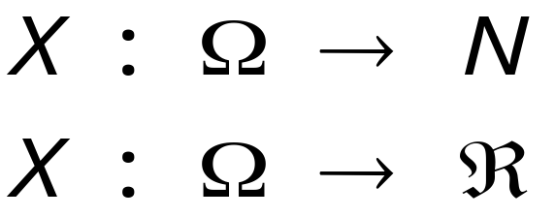
Random Variables
So far, event space that differs with every problem we look at
Random variables (RV) X allow us to talk about the probabilities of numerical values that are related to the event space
Event space → N (disc.) or R(cont.)
Notes:
Random Variable is a function from the sample space to the real number for continuous RV (Or to the integer numbers for discrete RV).
Because a RV has a numerical range, we can often do math more easily by working with the values of a RV rather then directly with events and we can define a probability for a random V

Slide 18
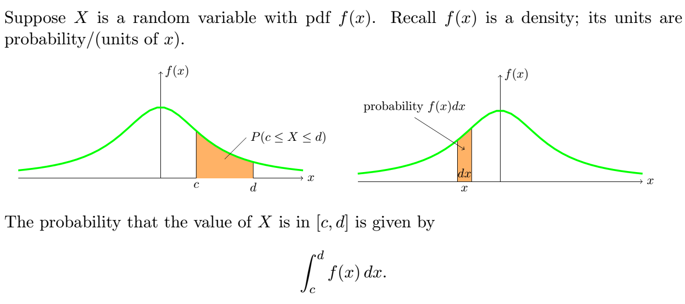

Continuous RV and pdf

Slide 19
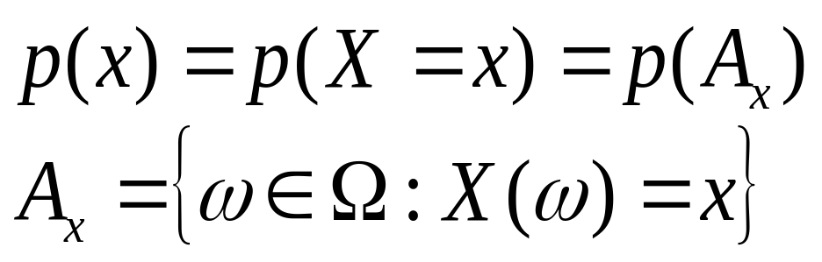
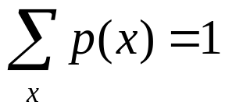

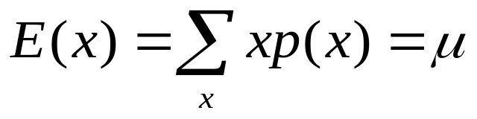
Expectation(期望值)
The Expectation is the mean or average（均值） of a RV

Slide 20
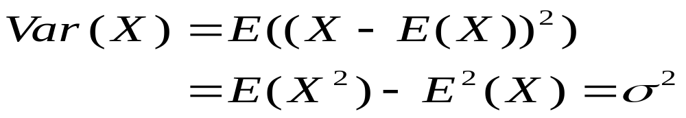
Variance(方差）
The variance of a RV is a measure of whether the values of the RV tend to be consistent over trials or to vary a lot
σ is the standard deviation
Notes:
Var(X)=E((X-E(X))^2)=sigma x, p(x)*(X-E(X))^2=sigma x, p(x)* (X^2 -2 x E(x) + E^2(x)) = sigma X^2 * p(x) – 2 sigma x * E(x) * p(x) + sigma E^2(x) * p(x) = E( x^2) – 2 E^2(x) + E^2(x) = E( x^2) – E^2(x)

Slide 21
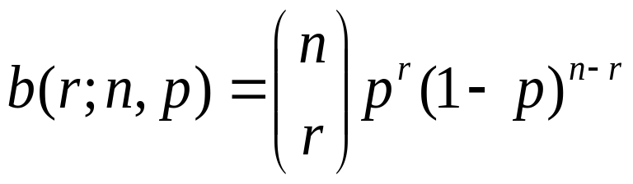
Binomial Distribution (discrete)
Series of trials with only two outcomes, each trial being independent from all the others
Number r of successes out of n trials given that the probability of success in any trial is p:
( ), also written as C^{r}_{n}, counts how many possibilities there are for choosing r objects out of n; = n! / (n-r)!r!
Expectation = np, variance = np(1-p)
Binomial distribution can describe coin toss.
n
r

Slide 22
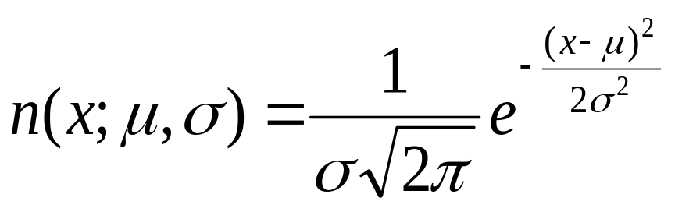
Normal (Gaussian) Distribution
Continuous
Two parameters: mean μ and standard deviation σ
e.g. for measurements of heights, lenghts, etc
For μ =0 and σ=1 called STANDARD NORMAL DISTRIBUTION

Slide 23
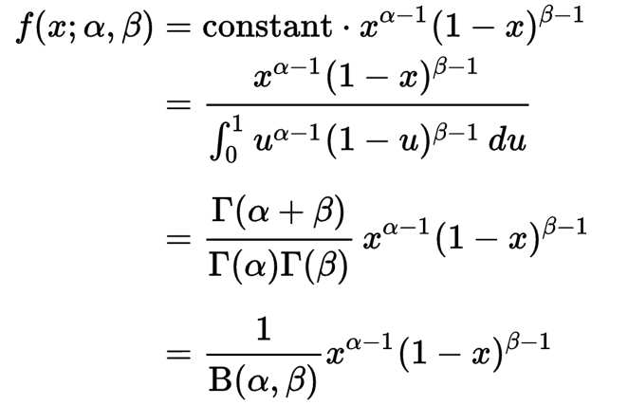
Beta Distribution (Continuous)
The pdf of the beta distribution Beta(α, β), for 0 ≤ x ≤ 1, and shape parameters α, β > 0, is as follows:

Slide 24
Probalility and Statistics applied to Language Modeling
In general, for language events, P is unknown
We need to estimate P, (or called model M of the language)
We’ll do this by looking at evidence about what P must be based on a sample of data

Slide 25
Estimation of P
Frequentist statistics (唯物)
  Look at facts only
Bayesian statistics (唯心)
  Prior beliefs updated by facts
  We are born Bayesian
Notes:
2 different approaches, 2 different philosphies

Slide 26
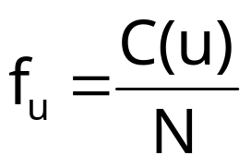

Frequentist Statistics
Relative frequency: proportion of times an outcome u occurs
C(u) is the number of times u occurs in N trials
For the relative frequency tends to stabilize around some number: probability estimates
Notes:
That this number exists provides a basis for letting us calculate probability estimates

Slide 27
Frequentist Statistics (cont)
Two different approaches:
  Non-parametric (distribution free)
  Parametric (with a priori belief) (Bayesian)

Slide 28
Non-Parametric Methods
No assumption about the underlying distribution of the data
e.g., simply estimate P empirically by counting a large number of random events is a distribution-free method
Less prior information, more training data needed

Slide 29
Parametric Methods
Assume that some phenomenon in language is acceptably modeled by one of the well-known family of distributions (e.g. binomial, normal)
We have an explicit probabilistic model of the process by which the data was generated, and determining a particular probability distribution within the family requires only the specification of a few parameters (less training data)

Slide 30

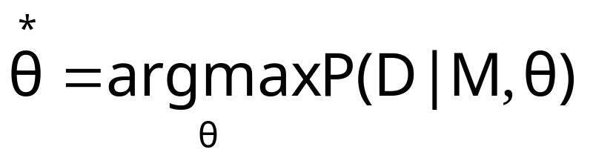
Frequentist Statistics
D: data
M: model (distribution P)
Θ: parameters (e.g. μ, σ)
For M fixed: Maximum likelihood estimate: choose such that

Slide 31

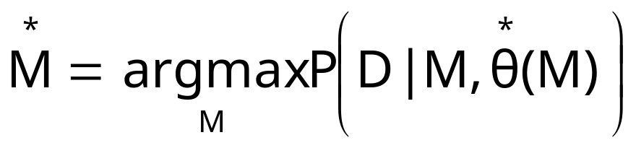
Frequentist Statistics
Model selection, by comparing the maximum likelihood: choose such that

Slide 32
Bayesian Statistics
Bayesian statistics measures degrees of belief
  From a frequentist point of view if I toss a coin 10 times and I get head 8 tiems, I would conclude that P(head) = 8/10: Maximum likelihood estimate
  But if nothing is wrong with coin, 8/10 is hard to believe: long run = ½, this is my a prior belief
Degrees are calculated by starting with prior beliefs and updating them in face of the evidence, using Bayes theorem
see http://www.abelard.org/briefings/bayes.htm for a very interesting account of BS
Notes:
First piece of data:
A town has two taxi companies, one runs blue taxi-cabs and the other uses black taxi-cabs. It is known that Blue Company has 15 taxis and the Black Cab Company has 85 vehicles. Late one night, there is a hit-and-run accident involving a taxi. It is assumed that all 100 taxis were on the streets at the time.
Second piece of data:
A witness sees the accident and claims that a blue taxi was involved. At the request of the defence, the witness undergoes a vision test under conditions similar to those on the night in question. Presented repeatedly with a blue taxi and a black taxi, in‘random’ order, the witness shows he can successfully identify the colour of the taxi 4 times out of 5 (80% of the time). The rest or 1/5 of the time, he misidentifies a blue taxi as black or a black taxi as blue.
Bayesian probability theory asks the following question, “If the witness reports seeing a blue taxi, how likely is it that he has the colour correct?”
As the witness is correct 80% of the time (that is, 4 times in 5), he is also incorrect 1 time in 5, on average.
For the 15 blue taxis, he would (correctly) identify 80% of them as being blue, namely 12, and misidentify the other 3 blue taxis as being black.
For the 85 black taxis, he would also incorrectly identify 20% of them as being blue, namely 17.
Thus, in all, he would have misidentified the colour of 20 of the taxis. Also, he would have called 29 of the taxis blue where there are only 15 blue taxis in the town!
In the situation in question, the witness is telling us that the taxi was blue.
But he would have identified 29 of the taxis as being blue. That is, he has called 12 blue taxis ‘blue’, and 17 black taxis he has also called ‘blue’.
Therefore, in the test the witness has said that 29 taxis are blue and only been correct 12 times!
Thus, the probability that the taxis the witness claimed to be blue actually being blue, given the witness's identification ability, is 12/29, i.e. 0.41.
When the witness said the taxi was blue, he was incorrect therefore nearly 3 times out of every 5 times. The test showed the witness to be correct less than half the time.
Bayesian probability takes account of the real distribution of taxis in the town. It takes account, not just of the ability of a witness to identify blue taxis correctly (80%), but also the witness’s ability to identify the colour of blue taxis among all the taxis in town. In other words, Bayesian probability takes account of the witness’s propensity to misidentify black taxis as well. In the trade, these are called ‘false positives’.
The ‘false negatives’ were the blue taxis that the witness misidentified as black. Bayesian probability statistics (BPS) becomes most important when attempting to calculate comparatively small risks. BPS becomes important in situations where distributions are not random, as in this case where there were far more black taxis than blue ones.
Had the witness called the offending taxi as black, the calculation would have been {the 68 taxis the witness correctly named as black} over {the 71 taxis the witness thought were black}. That is, 68/71 (the difference being the 3 blue taxis the witness thought were black); or nearly 96% of the time, when the witness thought the taxi was black, it was indeed black.
Unfortunately, most people untrained in the analysis of probability tend to intuit, from the 80% accuracy of the witness, that the witness can identify blue cars among many others with an 80% rate of accuracy. I hope the example above will convince you that this is a very unsafe belief. Thus, in a court trial, it is not the ability of the person to identify a person among 8 (with a 1/8th, or 12.5%, chance of guessing ‘right’ by luck!) in a pre-arranged line up that matters, but their ability to recognise them in a crowded street or a darkened alleyway in conditions of stress.

Slide 33
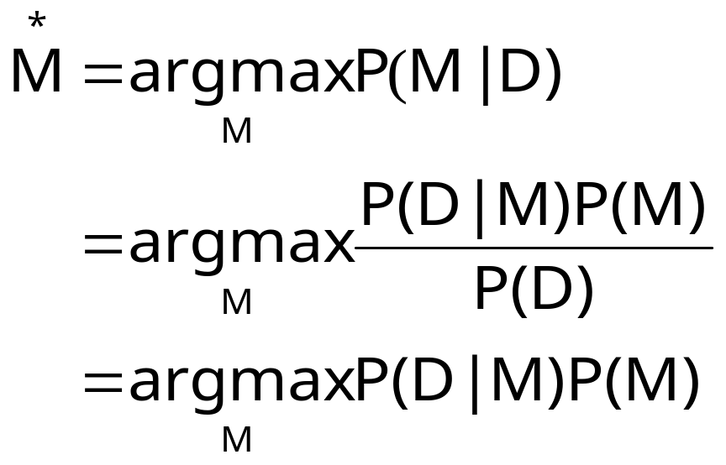
Bayesian Statistics (cont)
P(M): model a prior
Bayesian have prior beliefs of how likely the models are
P(M|D): model a posteriori

Slide 34
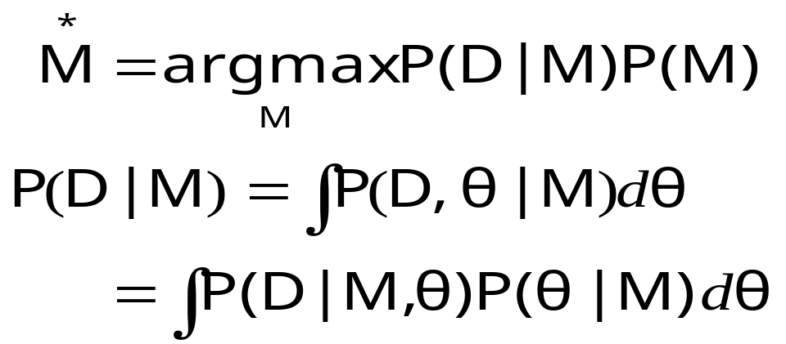
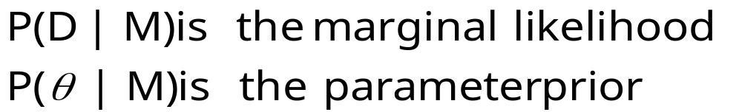
Bayesian Statistics (cont)
M is the distribution; for fully describing the model, I need both the distribution M and the parameters θ (对离散模型，把∫换成Σ）

Slide 35
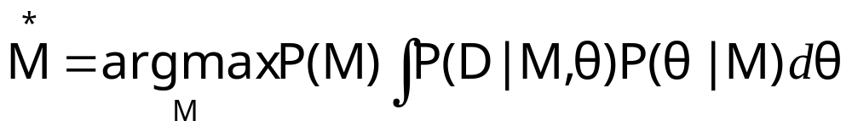
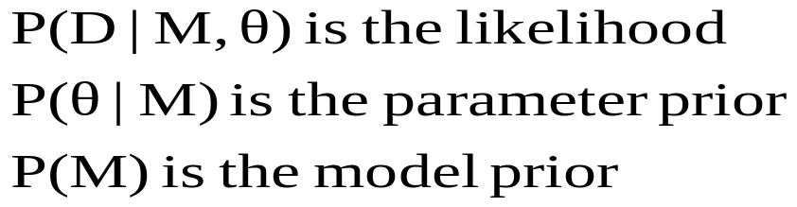
Frequentist vs. Bayesian
Bayesian (all models)
Frequentist (maximum likelihood model)
Notes:
Main point is that frequentists don’t use the parameter prior P(theta|M) because
The parameter exists, it’s not a probability, or belief.
Freq probability is to express things about the world, no belief

Slide 36
Bayesian Updating
How to update P(M)?
We start with a priori probability distribution P(M), and when a new datum comes in, we can update our beliefs by calculating the posterior probability P(M|D). This then becomes the new prior and the process repeats on each new datum

Slide 37
Bayesian Update Example
Suppose there are three types of coins which have different probabilities of landing heads when tossed.
  Type A coins are fair, with probability .5 of heads
  Type B coins are bent and have probability .6 of heads
  Type C coins are bent and have probability .9 of heads
Suppose I have a drawer containing 4 coins: 2 of type A,1 of type B,and 1 of type C. I reach into the drawer and pick a coin at random. Without showing you the coin I flip it once and get heads. What is the probability it is type A?Type B?Type C?

Slide 38
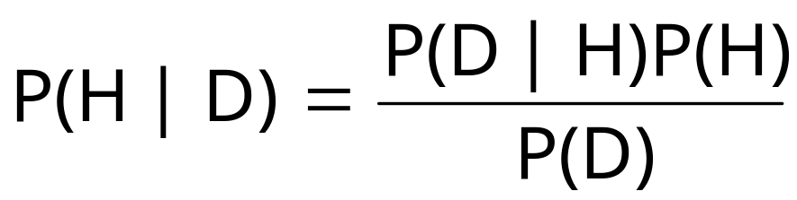
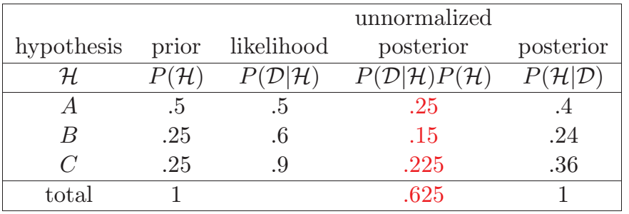
Bayesian Update Example

Slide 39
Bayesian Update Example 2
Suppose the coin toss has Beta(α, β) as its pdf. After k heads of n tosses, its posterior is Beta(α+k, β+n-k) (so it’s called a conjugate distribution to the coin toss model).
The Gaussian family is conjugate to itself (or self-conjugate) with respect to a Gaussian likelihood function: if the likelihood function is Gaussian, choosing a Gaussian prior over the mean will ensure that the posterior distribution is also Gaussian.

Slide 40
Bayesian Decision Theory
Suppose we have c models ; we want to evaluate which model is best in explaining some new data D:
  P(M_{i}|D)=P(D| M_{i} )P(M_{i} )/ΣiP(D| M_{i} )P(M_{i} )
If P(M_{i} |D) is max among all c models, we think it is the most likely model

Slide 41
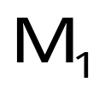

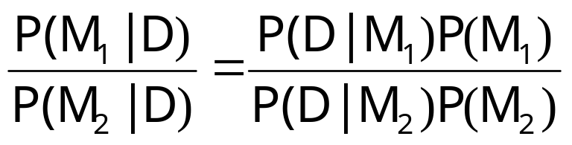
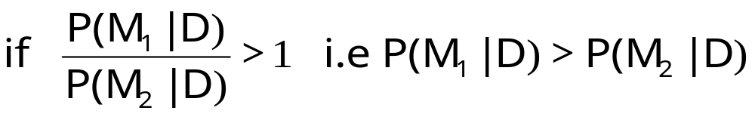
Bayesian Decision Theory
Suppose we have only 2 models and ; we want to evaluate which model better explains some new data D.
is the more likely model, otherwise

Slide 42
More about Model Selection
Refer to paper 请大家参考以下的经典论文：
Mark H. Hansen and Bin Yu，2001. Model Selection and the Principle of Minimum Description Length
http://www.stat.ucla.edu/~cocteau/papers/pdf/mdl.pdf

Slide 43
Essential Information Theory
Developed by Shannon in the 40s
Maximizing the amount of information that can be transmitted over an imperfect communication channel
Data compression is governed by entropy

Slide 44
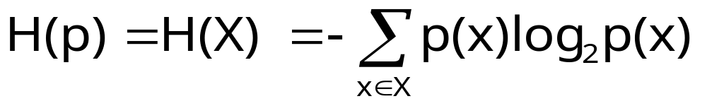
Entropy
X: discrete RV, p(X)
Entropy (or self-information)
Entropy measures the amount of information in a RV; it’s the average length of the message needed to transmit an outcome of that variable using the optimal code
it is measured in bits
Notes:
using the optimal code = the entropy will be the minimum

Slide 45
Using the Formula: Example
Toss a fair coin: W = {head,tail}
  p(head) = .5, p(tail) = .5
  H(p) = - 0.5 log₂(0.5) + (- 0.5 log₂(0.5)) = 1
Take a fair, 8-sided die: p(x) = 1 / 8 for every side x
  H(p) = - Σ i = 1..8 p(xi) log₂p(xi) = - 8 (p(x1) log₂p(x1) (since for all i p(xi) = p(x1) = 1/8) = -8x ((1/8)x (-3)) = 3 (now you see why it’s called bits?)
An unfair coin:
  p(head) = .2 ... H(p) = .722; p(head) = .01 ... H(p) = .081

Slide 46
“Coding” Interpretation of Entropy
The least (average) number of bits needed to encode a message (string, sequence, series,...) (each element having being a result of a random process with some distribution p): = H(p)
Remember various compressing algorithms?
  they do well on data with repeating (= easily predictable = low entropy) patterns
  if data have high entropy then compressing is hard

Slide 47
Coding: Example
How many bits do we need for ISO Latin 1?
  the trivial answer: 8
Experience: some chars are more common, some (very) rare:
    ...so what if we use more bits for the rare, and less bits for the frequent? [be careful: want to decode (easily)!]
    suppose: p(‘a’) = 0.3, p(‘b’) = 0.3, p(‘c’) = 0.3, the rest: p(x)≈ .0004
    code: ‘a’ ~ 00, ‘b’ ~ 01, ‘c’ ~ 10, rest: 11b1b2b3b4b5b6b7b8 (10 bits)
    code acbbécbaac: 0010010111000011111001000010
    a c b b é c b a a c
    number of bits used: 28 (vs. 80 using “naive” coding)
huffman code is optimal that’s related to entropy; but huffman code is integer coding; arithmatic coding is a better choice
Notes:
http://dogma.net/markn/articles/arith/part1.htm

Slide 48
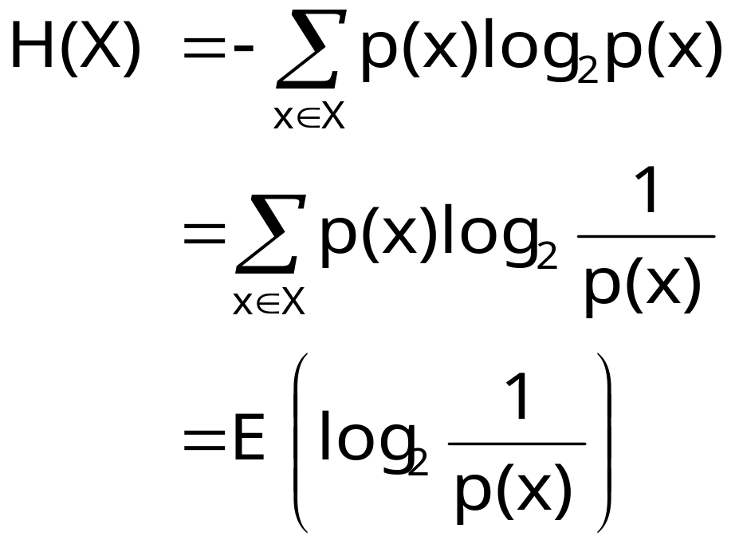
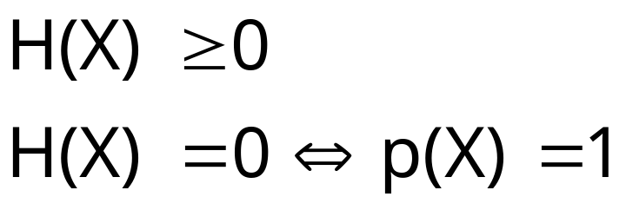
Entropy (cont)
i.e when the value of X
is determinate, hence
providing no new
information
Notes:
H is a weighted average for log(p(X) where the weighting depends on the probability of each x
H INCREASES WITH MESSAGE LENGTH

Slide 49
we define 0 log₂ 0 = 0
for | Ω | = n: H(p) <= log₂n
    nothing can be more uncertain than the uniform distribution

Slide 50
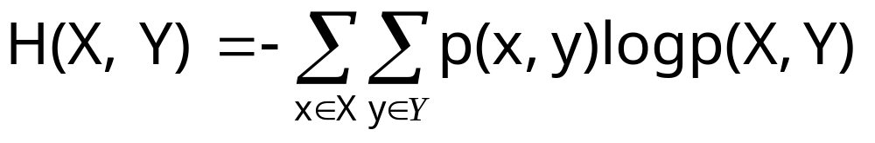
Joint Entropy
The joint entropy of 2 RV X,Y is the amount of the information needed on average to specify both their values

Slide 51
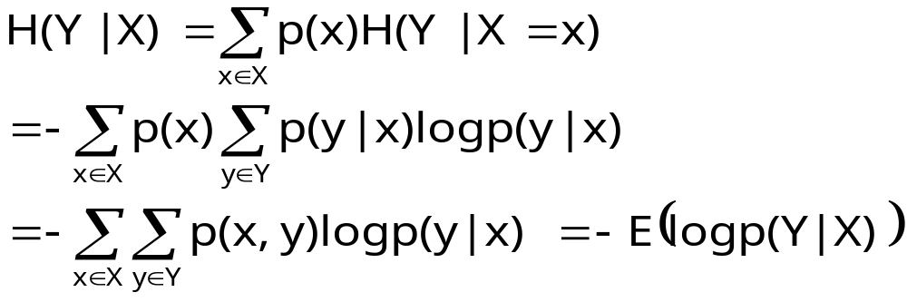
Conditional Entropy
The conditional entropy of a RV Y given another X, expresses how much extra information one still needs to supply on average to communicate Y given that the other party knows X

Slide 52
Chain Rule
H(X,Y)=E(log(p(x,y))=E(log(p(x)p(y|x))
=E(log(p(x))+E(log(p(y|x))
=H(X) + H(Y|X)

Slide 53
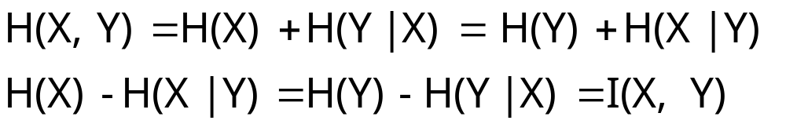
Mutual Information
I(X,Y) is the mutual information between X and Y. It is the reduction of uncertainty of one RV due to knowing about the other, or the amount of information one RV contains about the other
It measures the mutual dependence of two random variables.

Slide 54
Mutual Information (cont)
I is 0 only when X,Y are independent: H(X|Y)=H(X)
H(X|X) = 0 (because p(x|x)=1)
H(X)=H(X)-H(X|X)=I(X,X) Entropy is the self-information
Notes:
For 2 dependent variables, I grows not only with the degree of their dependence but only with their entropy
H(X) = I(X<X)
This explain also how mutual information between 2 totally dependent variables is not constant but depends on their entropy

Slide 55
I(X,Y)=H(X)-H(X|Y)=H(X)-(H(X,Y)-H(Y))
=H(X)+H(Y)-H(X,Y)
= Σx p(x)log(1/p(x))+
Σy p(y)log(1/p(y))+
Σx,y p(x,y)log(p(x,y))
=Σx,y p(x,y)log(p(x,y)/p(x)p(y))

Slide 56
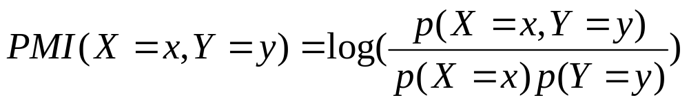
Pointwise Mutual Information
PMI measures the mutual dependence of between two instances or realizations of random variables.
  Positive => high correlated
  Zero => no information (independence)
  Negative => opposite correlated
The equation of PMI:

Slide 57
Use of PMI
PMI can measure the strength of Chinese characters in a collocation. PMI可用来计算2个汉字之间的搭配强度
Extracted 2-character collocations from an Ancient Corpus:
  𪖏𪖍 freq= 5, pmi=19.74 𥕍𥕏 freq= 5, pmi=19.55
  𥸞𥸛 freq= 8, pmi=19.45 𥷳𥸞 freq= 7, pmi=19.45
  𥸛𥸟 freq= 7, pmi=19.45 𪆄𪃐 freq= 5, pmi=19.40
  𦢏𦞙 freq= 6, pmi=19.33 𪖂𪕭 freq= 5, pmi=19.25
  𣶱𣿪 freq= 11, pmi=19.04 𩵚𩻗 freq= 5, pmi=19.04
However, PMI favors low-frequency words

Slide 58
property of entropy
H(X,Y)<= H(X)+H(Y)
equality iff X,Y independent
H(Y|X) <= H(Y)
conditional entropy is better (because we have more information)
I(X,Y)>= 0
http://cgm.cs.mcgill.ca/~soss/cs644/projects/simon/Entropy.html for some proofs

Slide 59
Entropy and Linguistics
Entropy is measure of uncertainty. The more we know about something the lower the entropy.
If a language model captures more of the structure of the language, then the entropy should be lower.
We can use entropy as a measure of the quality of our language models
Notes:
2) Means better code; optimal code entropy minimum!!
Entropy of the language Exists in the world; but we don’t know it
(we don’t know P); we can only look for better code hoping to lower the
Entropy

Slide 60
Entropy and Linguistics
H: entropy of language; we don’t know p(X); so..?
Suppose our model of the language is q(X)
How good estimate of p(X) is q(X)?

Slide 61
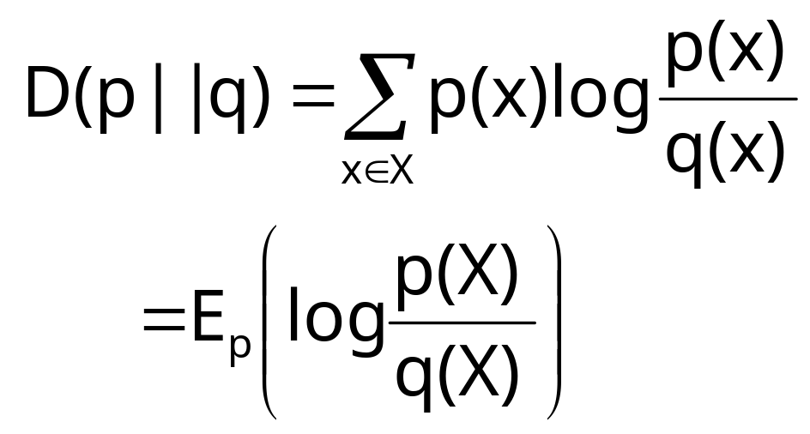
Entropy and Linguistics
Kullback-Leibler Divergence
Relative entropy or KL (Kullback-Leibler) divergence

Slide 62
I(X,Y) = D(p(x,y) || p(x)p(y))
D(p||q) is asymmetric, but I(x,y) is
I(X,Y) = I(Y,X)
D(p||q) is non-negative
(http://en.wikipedia.org/wiki/Gibbs%27_inequality)

Slide 63

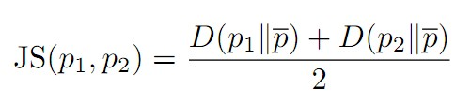
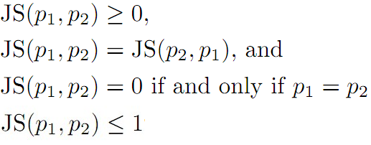
Jensen-Shannon Divergence
JSD is not metric, but its sqr IS.

Slide 64
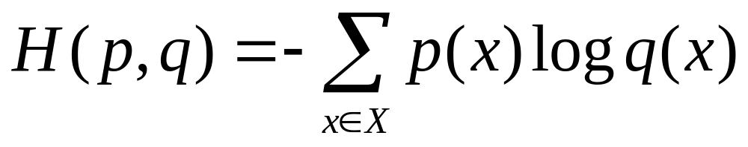
cross entropy
Given a random variable X with true distribution p and a probability model q, the cross entropy H(p,q) is defined as:
H(p,q)=D(p||q)+H(p)

Slide 65
Entropy and Linguistics
KL divergence measures of how different two probability distributions are
Average number of bits that are wasted by encoding events from a distribution p with a code based on a not-quite right distribution q
Goal: minimize relative entropy D(p||q) to have a probabilistic model as accurate as possible

Slide 66
entropy and language model
a language model is a probability function on the language:
eg. n-gram model m(w|h): predict next word w based on previous seen words h
if a word is always predicted, then no surprise is generated. we define pointwise entropy as surprises:
H(w|h)=-log₂ m(w|h)

Slide 67
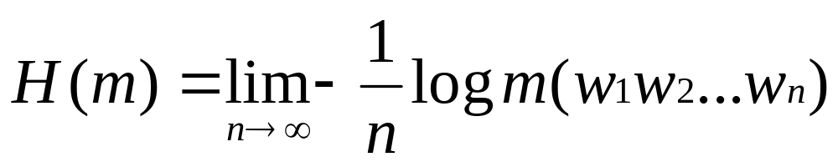
summing over the surprise of our model at each word gives the average surprise:
H = -1/nΣ_{j=1..n} log m(w_{j}|w1,w2,...w_{j-1})
=-1/nlog m(w1,w2, w_{n}) (from chain rule)
this measures the strength of our model. ideally, n should be very large to be accurate, so define

Slide 68
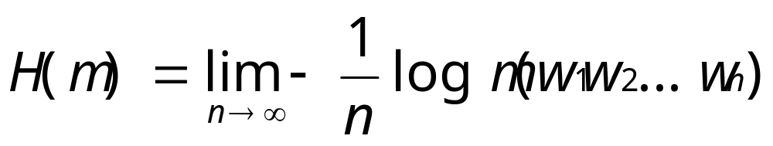
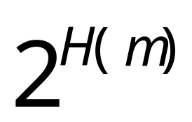
perplexity
perplexity is defined as:
it means the average number of choices (surprises) a model has at any given point.
  The fewer choices the better → the lower the perplexity the better the model
当然，n无穷大是不可能的，只要足够大就可以了。

Slide 69
The Noisy Channel Model
The aim is to optimize in terms of throughput and accuracy the communication of messages in the presence of noise in the channel
Duality between compression (achieved by removing all redundancy) and transmission accuracy (achieved by adding controlled redundancy so that the input can be recovered in the presence of noise)

Slide 70
The Noisy Channel Model
Goal: encode the message in such a way that it occupies minimal space while still containing enough redundancy to be able to detect and correct errors
W
X
Y
W*
Channel
p(y|x)
encoder
decoder
message
input to
channel
Attempt to
reconstruct
message based
on output
Output from
channel
Notes:
P is a property of the channel; I have control over p(X): design of the code

Slide 71

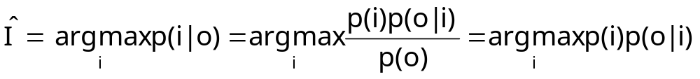
Linguistics and the Noisy Channel Model
In linguistic we can’t control the encoding phase. We want to decode the output to give the most likely input.
I
O
Noisy Channel
p(o|I)
decoder
Notes:
Many problems in SNLP can be constructed as an attempt to determine the most likely
Output given a certain input

Slide 72
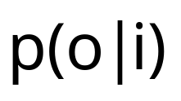
The noisy Channel Model
p(i) is the language model and is the channel probability

Slide 73
Noisy Channel Model
application | input | output | p(i) | p(o|i)
machine translation | word sequence of L1 | word sequence of L2 | p(L1) language model | translation model
OCR | actual text | text image | language model | model of OCR errors
POS tagging | tag sequences | words | prob of tag sequences | p(w|t)
speech recognition | word sequence | speech signal | prob of word sequences | acoustic model
Note：I/O is inverted for problems 输入输出是倒过来的

Slide 74
homework
compute the entropy of the English letters/Chinese characters (they were reported to be 4.03/9.65)，and the English/Chinese word．Use files ‘chn’ and ‘eng’. compare your results with those published on the papers/books/web. Consider the impact of Chinese character entropy on Chinese encoding and processing. Is Chinese an inferior language to English?

Slide 75
homework
Language Identification. How to detect if a text is written in Simplified or Traditional Chinese? (Hint: KL). And further, how to identify the language of a web page in a multilingual website? 语言识别问题:如何识别简体汉语和繁体汉语?（提示：KL）如何识别多国语言文字?

Slide 76
Further Reading
Cover, T. M. and Thomas, J. A. (1991). Elements of Information Theory. New York: John Wiley & Sons.

Slide 77
Linguistic Essentials for NLP

Slide 78
Outline
Basic Linguistics
Lexicons
Corpus

Slide 79
Basic Linguistics
Words are grouped into Classes, each bearing a specific label called part-of-speech, or POS in short.
e.g. English words are classified into nouns, verbs, adjectives, adverbs, pronouns, conjunctions, determiners, ...
there are two main groups: open word classes and closed word classes. The former is dynamic in a language and the latter includes mostly functional words.

Slide 80
POS tags
we will introduce some of them later, e.g. Brown tags
A word may belong to one or more classes,兼类词
词性标注就叫POStagging

Slide 81
morphology
words are not atomic units in forms, e.g. in most European languages. They are related, even in Chinese. (e.g.?)
e.g. Nouns have plural or singular forms. 或者阴阳性
In English, three morphological processes related to word formation are: inflection, derivation, and compounding.

Slide 82
inflexion: grammatical (tense/aspect/number/gender/...)
derivation: syntactic, functional, semantic
compounding: a+b

Slide 83
syntactical functions
words have syntactic functions in a sentence. e.g. nouns can act as subjects and objects, etc...
but functions depend on structures
words combine to form a sentence, the study of which is called the syntax.

Slide 84
syntax: phrase structures
Chomsky studied phrase structures, and put forward a theory of formal languages
context free grammars are the most useful in NLP
CFG=<T,N,S,P>, eg
S -> NP VP N -> Simon
VP -> V NP N -> Moscow
NP -> N V -> sent
VP -> V V -> likes

Slide 85
Phrase Structure Tree: Parsetree
S
VP
VP PP
NP
VP NP NP
N V N P N
Moscow sent soldiers into Afghanistan

Slide 86
Syntactic function revisited
Subject can be defined as the relation between a main verb and the NP before it.可以把主语定义为主动词前的NP和VP的关系
We can define attribution as the relation between the noun and its modifiers. 可以把定语定义为名词及其修饰语的关系

Slide 87
syntax: dependency
no nonterminals
all syntactic relations are word-level
Sent
adv
subj
obj
into
pobj
Moscow soldiers Afghanistan

Slide 88
Advantages of Dependency Grammar
依存文法的优点
Simple 简单
Cross-lingual 跨语言性
Function is labelled directly 直接得到语法功能
It is easier to get semantic functions 容易计算“语义功能”

Slide 89
subcategorization
though two words may belong to one POS class, they can behave quite differently syntactically
one way is to enlarge the POS tag set, another is called subcategorization. e.g. a verb can be further categorized according to the numbers and types of the complements it can go along

Slide 90
in this way, verbs can be classified as intransitive, transitive, ditransitive, ...
do you have Longman Dictionary of Contemporary English?
what do t5, d6 mean?
the number of complements a verb takes is called its valency.
what is the valency of rain?

Slide 91
lexicons/dictionaries
a lexicon = a set of entries, each entry is a word/phrase
lexicons differ in the information which is contained in each entry
Many kinds of information can be specified in an entry: orthographic, phonetic, syntactic, semantic, usage/examples, translational
we will show what a typical lexicon is by looking at a few lexicons

Slide 92
汉语语法信息词典
开发单位：北京大学计算语言学研究所
参考文献：
俞士汶等（1998）《现代汉语语法信息词典详解》，清华大学出版
社、广西科学技术出版社1998年版。
规模：7万多词条
分总库和不同词性库
名词、时间词、处所词、方位词、数词、量词、区别词、代词、动词、形容词、状态词、副词、介词、连词、助词、语气词、前接成分、后接成分、成语、简称略语、习用语、语素、标点符号
有些词性还有分库，如动词、代词

Slide 93
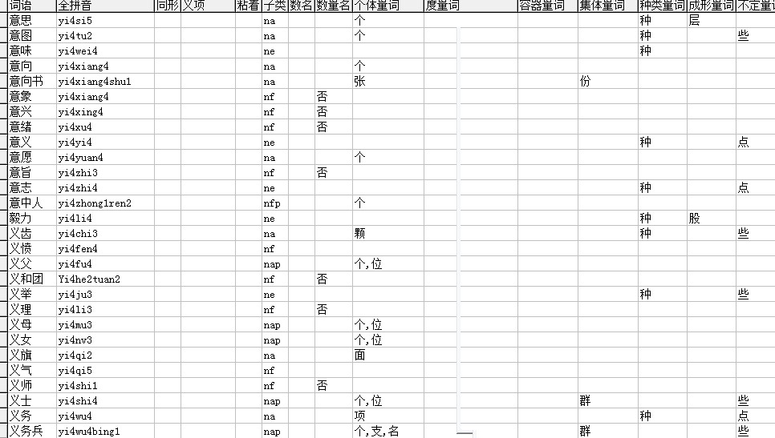
Peking Univ. Dictionary for Chinese

Slide 94
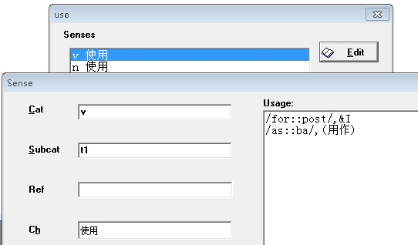
Neon English-Chinese Lexicon
For rule-based machine translation. Contains only translation-related info

Slide 95
知网（Hownet）
发明人：Prof. Dong 机器翻译专家董振东
网址：http://www.keenage.com/
特点：Describe words by primitive concepts 用义原来描述词语
Semantic relations between words also annotated, forming a conceptual network.词汇之间有语义关系，构成概念网络，故称知网

Slide 96
WordNet
网址：https://wordnet.princeton.edu/
Developed by 开发单位：
George A. Miller Princeton University 普林斯顿大学心理语言学实验室
Wide Application in NLP 在自然语言处理中得到广泛的应用
Free lexical database for Englsh 免费的在线词汇数据库
世界很多语种都开发了类似的相应的版本，如
各种欧洲语言：EuroNet
汉语：CCD（Chinese Concept Dictioanry）

Slide 97
WordNet
Represents concepts by set of synonyms (synset) 用同义词集表示概念
Semantic relations between concepts (e.g. hyponymy and hypernymy) also annotated 概念之间有语义关系，如上下位，...
Wordnet演示（略）

Slide 98
多语词典Papillon
http://www.papillon-dictionary.org
完全免费，目前有英、法、日、马来、老挝、泰、越南、中文

Slide 99
Corpus 语料库
Corpus are collections of lingustic data. 语料库是语言材料的集合。不同的语言材料、不同的收集方式构成了不同的语料库。
Features of corpus 语料库的特点
real 真实性：自然产生，不加修饰
digitized 数字化：以计算机为载体，可检索
Processed 大部分语料库都为了某种目的经过加工处理。未处理的：“生”。处理好的：“熟”

Slide 100
Classifications 语料库的分类
Speech/Text 语音/文本
Spoken/Written 口语/书面语
Monolingual/Bilingual/Multilingual 单语/双语/多语
Segmented/Tagged/Parsed 切分/词性标注/语义标注/树库
Bilingual 双语：按“单词/词组/句子/段落”对齐
Balanced/specific 均衡/专门
Other 其他分类属性：如现代／古代

Slide 101
Searching of Corpora
语料库的查询
Big corpora have their custom search software 一般都提供相应的检索软件
BNC: sara
Penn Treebank: tgrep
AntConc can be used for your own corpora.
Regular Expression search is very useful for small corpora 对于小型的文本语料库，一般可用正规表达式检索

Slide 102
Some corpora 代表性语料库
1963 First corpus：Brown Corpus
1987(?) Colins Cobuild
1991-1994 BNC 1.0; 2000 BNC World Edition
1993- Penn treebank
1999-2001 PKU people’s daily corpus 北大人民日报标注语料库 2700万字

Slide 103
Introduction to Famous Corpora
著名语料库介绍
Brown Corpus
Francis and Kucera, Brown University, 1963
一百万词的通用语料库。15个类别，500篇文章，每篇2000词。内容包括新闻、宗教、小说、信件等。

Slide 104
Famous Corpora 著名语料库介绍
Cobuild “Bank of English” corpus
1987(?): 7.3 million
1990(?): 13 million
1997: 300 million
2002.1: 450 million words,
可以联机检索 56m
http://titania.cobuild.co.uk/form.html

Slide 105
Famous Corpora 著名语料库介绍
Penn Treebank
Treebank I: 三百万词（包含Brown Corpus）1993
Treebank II: 一百万词 1995
中文树库（第一版）：10万词，4185个句子 2000年
http://www.cis.upenn.edu/~treebank/ www.ldc.upenn.edu/ldc/online/treebank/index.html

Slide 106
Famous Corpora 著名语料库介绍
BNC world edition：1 亿词，经过自动词性标注
http://thetis.bl.uk/lookup.html

Slide 107
Chinese Corpus
PKU People’s Daily tagged corpus 北京大学人民日报标注语料库
机器自动标注，人工校对。公开一个月
台湾中研院平衡语料库
http://www.sinica.edu.cn/SinicaCorpus/
香港城市大学Livac共时语料库
http://www.livac.org

Slide 108
Superfection Corpus至善语料库
Monolingual 单语：人民日报，解放日报；繁体语料
Bilingual 双语：英汉，国内最大(也称至善句库)
Online searching 提供联机检索（ http://121.192.180.172/ ）

Slide 109
LDC and Chinese LDC
LDC: Lingusitic Data Consortium
Lots of corpora 这两个机构都提供大量语料库
Nonfree 语料一般都是要收费的
网址:http://ldc.uppen.edu/
  http://www.chineseldc.org/
  我们购买了他们的很多语料库!

Slide 110
Tagging of Corpora
语料库的标注
Tagged corpora are more useful 加过工的语料库用处更大
Tagging 标注：word segmentation/POS tagging/Parsing/Semantic Tagging 分词/词性/句法/语义
We’ll talk about them later

Slide 111
词性标注集介绍
Brown Tagset
BNC tagset
Penn Tree Tagset
PKU tagset 北大标记集

Slide 112
Brown tagset
226 tags，有 determiner 限定词，动词BE, connective 连词，动词DO，there，foreign word 外来词，动词have，prepositions 介词，adjectives 形容词，modal 情态词，noun 名词，前修饰词（completely,so），后修饰词（enough,indeed）,adverb 副词，verb 动词，WH词，人称代词等，另有很多复合标注记号，如WDT+DO+PPS 表示whaddya ，WRB+MD 表示where‘d 等
http://www.comp.leeds.ac.uk/amalgam/tagsets/brown.html

Slide 113
BNC tagset标注集
The basic set 基本集 is called C5 tagset ，57 个 tags 标记+4个 punctuations 标点
形容词（3），冠词，副词（3），连词（3），数词（2），限定词（3），there，叹词，名词（4），代词（4），‘s，介词（2），to（不定式），unc(未分类)，动词（25），not，字母。
http://www.natcorp.ox.ac.uk/docs/bnc2guide.htm

Slide 114
Penn Treebank tagset
Tagset for Penn treebanks 用来标记树库，36标记集（不算标点）
http://www.cis.upenn.edu/~treebank/
与C5的不同: IN, TO, ...

Slide 115
Peking Univ. Tagset北大的标注集
原来用 26 个字母表示
最近增加了活用时的词性变化标记，以及对语素的细致的划分，达到100多个标记。
有关信息: http://www.icl.pku.edu.cn/
我们的分词程序的标记集也是在北大基础上修改的

Slide 116
词性标注决不是那么简单
Tagging is not that simple
I once asked a grad. Student of Department of Chinese to do tagging, and after a while he gave up 曾经让中文系的研究生秦少康做手工词性校对，但是他放弃了
一份北大人民日报语料库的修改笔记

Slide 117
Famous Corpus Research Centers
著名语料库研究机构
Centre for Corpus Linguistics (CCL), Department of English at the University of Birmingham
Sinclair，Teubert
200亿语料库：研究词汇变迁和新词
汉英翻译库：2亿词双语语料库
UCREL，Lancaster University
Leech
Peking Univ. 北京大学， 俞士汶
City Univ. of Hongkong 香港城市大学，邹嘉彦

Slide 118
Corpus linguistics 语料库语言学
No corpus, no linguistics 语料库语言学是一种解决语言学问题的有效途径. (e.g. collocations 搭配的定量研究 )
注重语言事实的客观、定量描写
you have to look at at least ten examples before formulating a rule. “例不十，法不立”
精确的数据
Software tools are necessary 利用软件工具

Slide 119
size does matter
太小的语料库，统计数据不准确
Web as a corpus
http://www.google.com/
British Birmingham City University
WebCorp: http://www.webcorp.org.uk/

Slide 120
The bigger the better?
语料库是不是越大越好呢
Zipf’s Law
if we assign ranks to all the words in a corpus according to their frequencies, then:
f*rª =b with the exponent a close to 1
Simply put 简单地说：
r_{w} * f_{w} = constant (常数)。
Actually, this law applies to not only word counts, but many things that can be counted . 其实，这个规律不仅适用于单词，适用于很多可以count的语言现象。

Slide 121
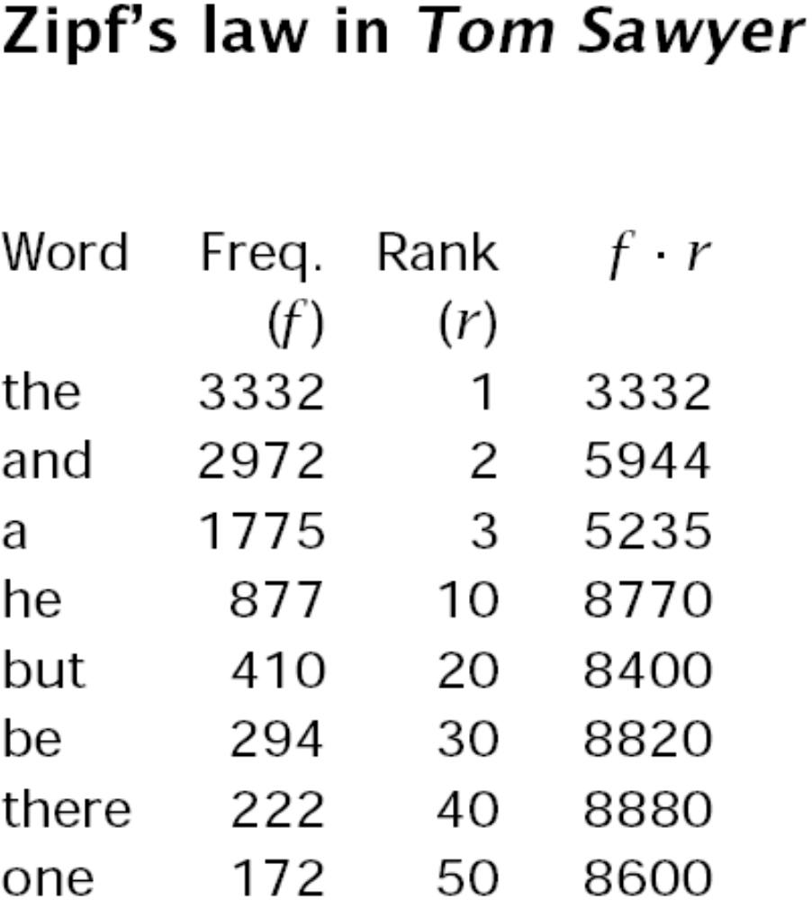

Slide 122
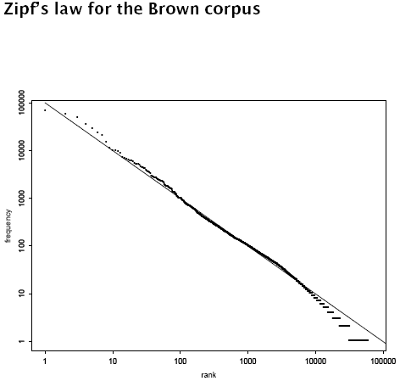

Slide 123
mandelbrot’s law
f * (r + p1)ª = b
A generalization of Zipf’s law 是对Zipf定律的推广
大家知道我给自己取的名字的来源了吗？hehe

Slide 124
There are all kinds of birds in a big forest. But what can one tell from just one bird? 林子大了，什么鸟都有。一只鸟又能说明什么问题呢？
For uncommon words, statistics are unreliable. 对非常用词，统计数据永远是稀疏的。
因此：光“大”不行 –大而无当
语料库的选材（内容）更重要。
For dead corpus, the bigger the better. 如果语言是死的（古文？）那么，自然越大越好了。

Slide 125
homework
Read Michael Rundell’s article: ‘The corpus of the future, and the future of the corpus’，and what’s your idea on corpus based research?
Use the people’s daily corpus（http://cloudtranslation.cc/corpus_sc.html） to learn the use of the Chinese word“下岗”.
Read the Chinese PennTreeBank tagging manual.

Slide 126
Project
How to divide the superfection parallel corpora into domain corpora? 考虑把至善句库进行专业分类。Related questions 相关问题：
  How to define a domain? 如何确定专业？
  Domain lexicon 专业词表？
  Domain hierarchy 专业的体系（tree树、graph图？）
  Cross-disciplinary domain 交叉学科带来的问题？
  Auto-update of vocabulary 专业词表的自动更新？
  专业词表翻译的问题？

Slide 127
Project
Write a program that can search a big corpus (at least a million words) using regular expressions very fast.

